Slide 1
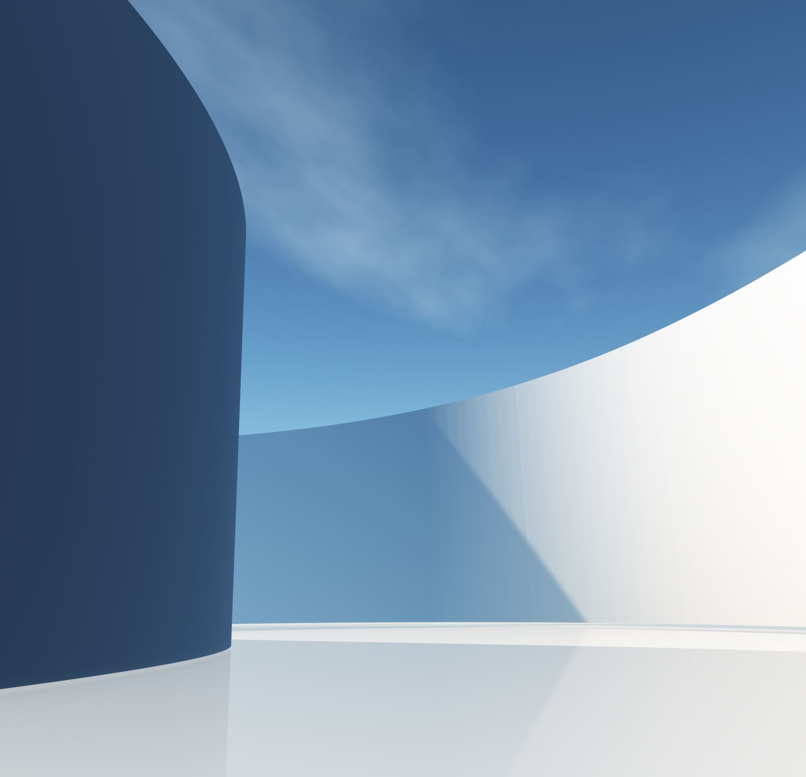

Project 3
Sean Novis
Notes:
]

Slide 2
Project Overview
Interactive Command Line Interface (CLI) that allows users to see a range of information about video games and characters

Slide 3
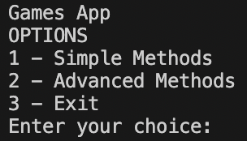

Slide 4
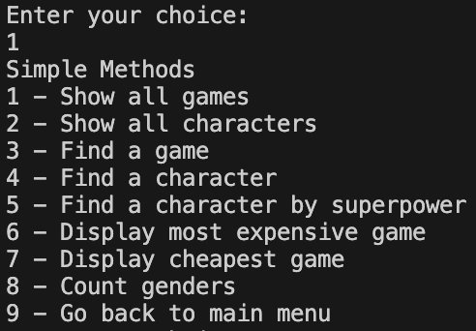
Simple Methods

Slide 5
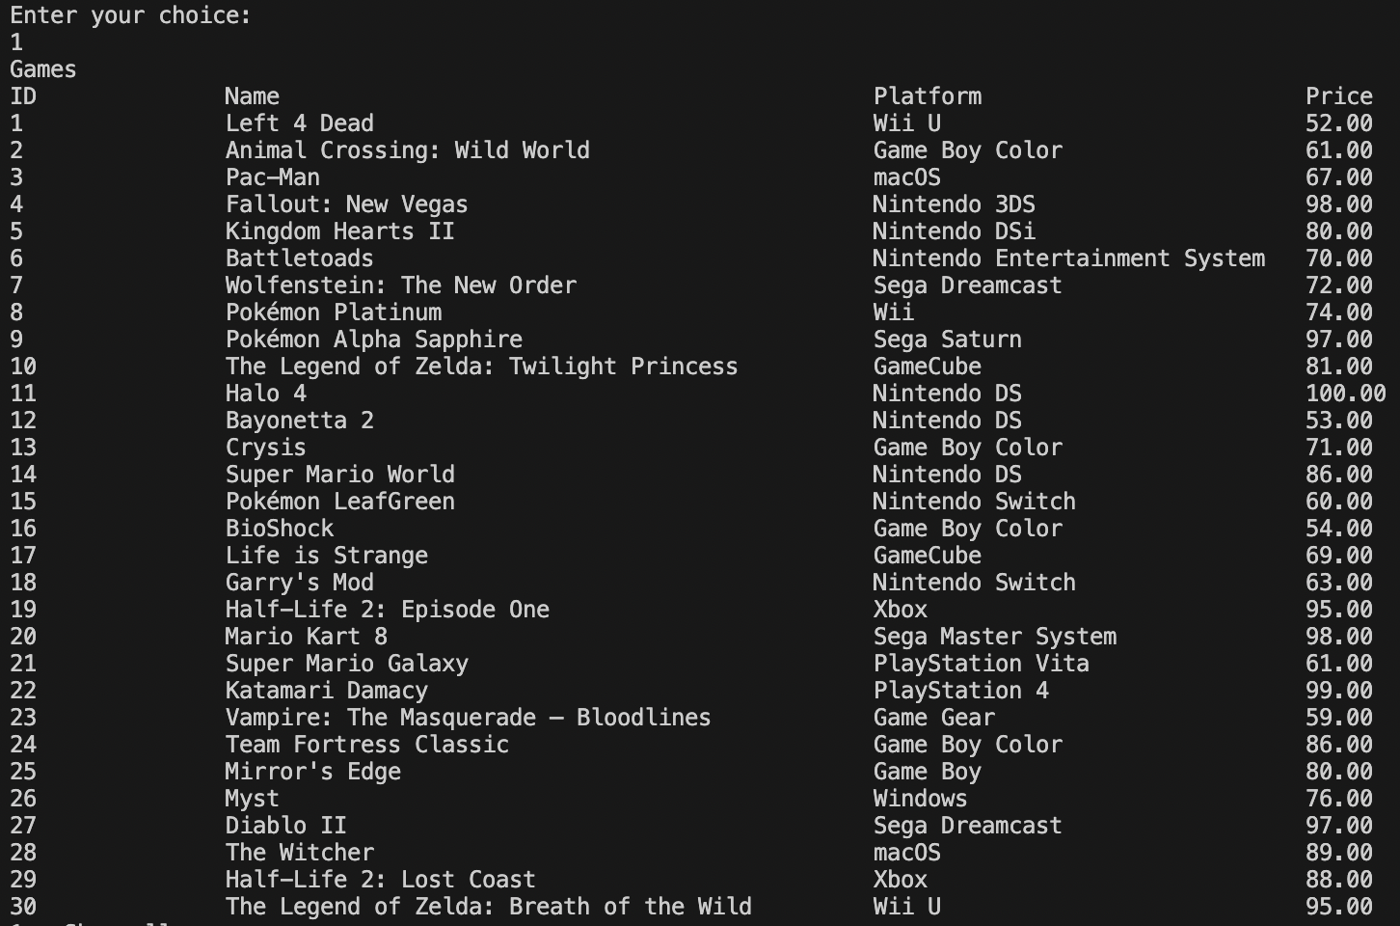

Slide 6
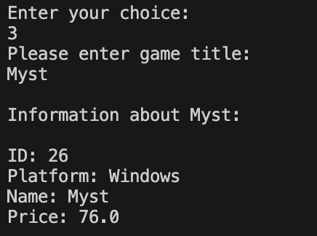



Slide 7
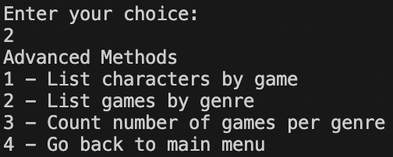
Advanced Methods

Slide 8
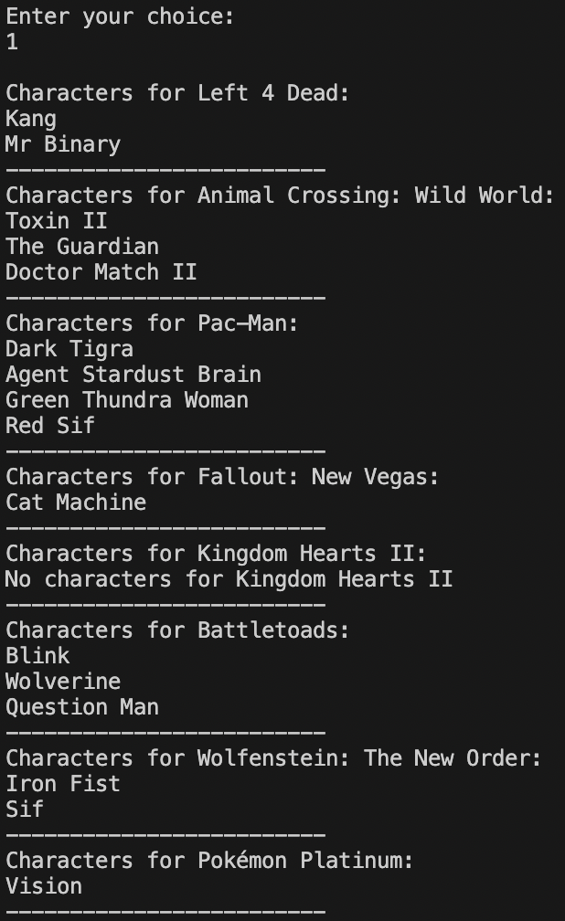
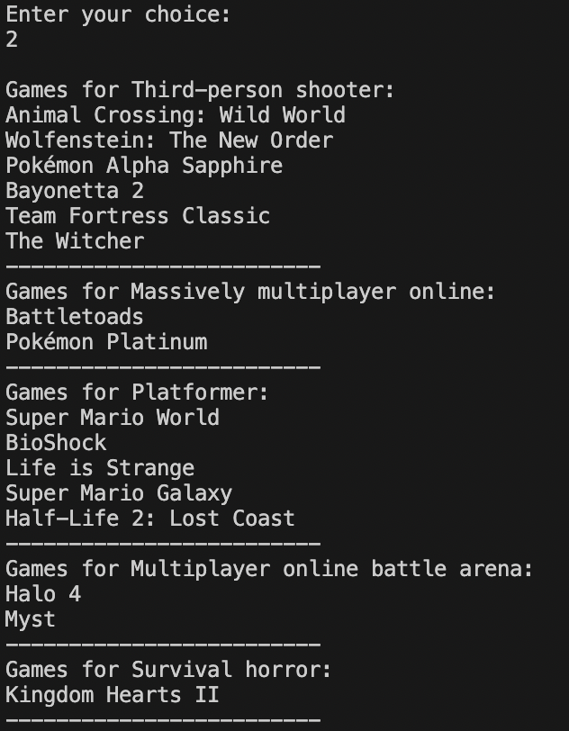

Slide 9
